Slide 1
Plague Programmers
Analysis of US Covid cases
Nick Nasse, Stephen Kanaski, Hany sedarous

Slide 2
Dataset – New York Times Covid Database
With no publicly available federal database, The New York Times (NYT) has created a database that attempts to track every known US Covid-19 case and death by aggregating and cross-referencing State and County reported data.
NYT Article Explaining the Project: https://www.nytimes.com/article/coronavirus-county-data-us.html
Github with Info: https://github.com/nytimes/covid-19-data

Slide 3
Data Loading & Site Creation
We used Flask as our web framework with the following routes:
/ - loaded the CSV into a MongoDB collection
/data - pulled the data from MongoDB collection and hosts it on the site as JSON
/home - html rendered template that contains links to the 3 visualization pages
Visualization Pages (/vis_1, /vis_2, /vis_3)
Pulls data from /data
Renders HTML from Template
Uses different JS libraries to plot the data
Plots can be dynamically updated with dropdown menu powered by JS

Slide 4
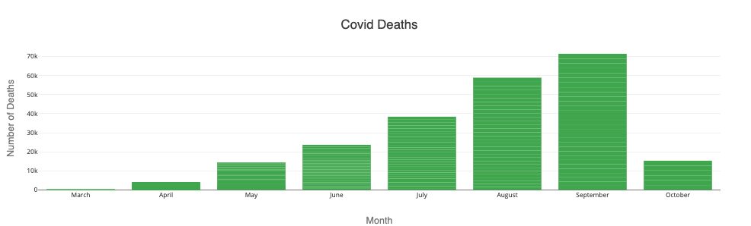
Analysis 1: Covid deaths Per month
Visualization = Bar Graph
JS Library = Plotly
Filterable by State

Slide 5
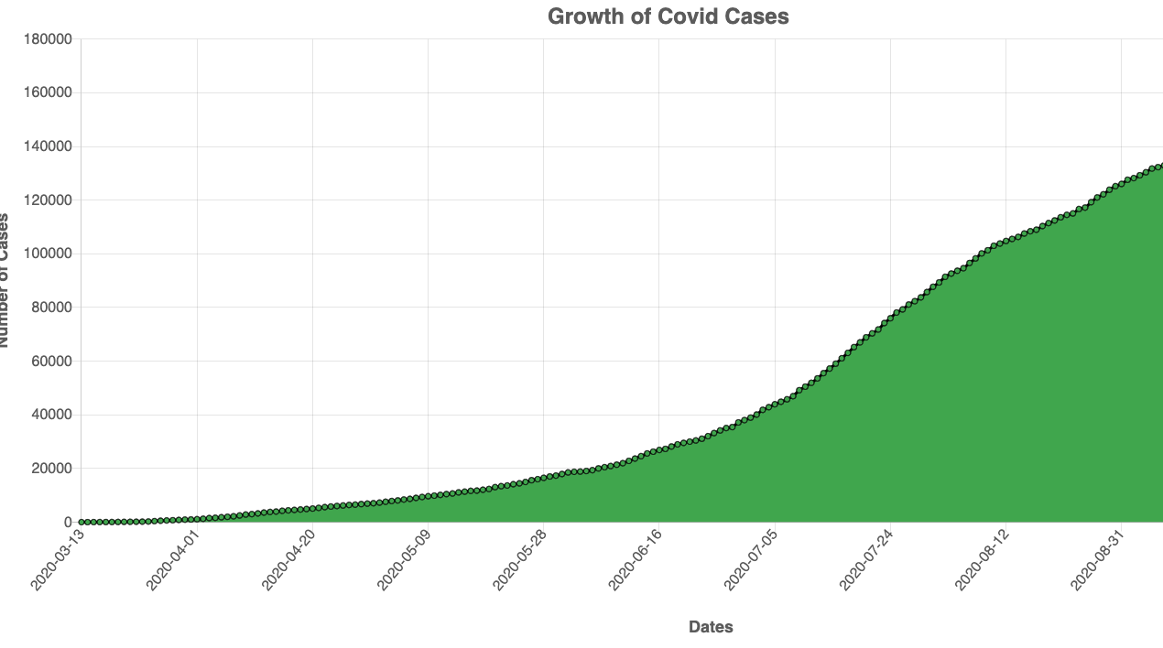
Analysis 2: Covid Cases by date
Visualization = Line Graph
JS Library = Chart.JS (JS Library we haven’t used before)
Filterable by State

Slide 6
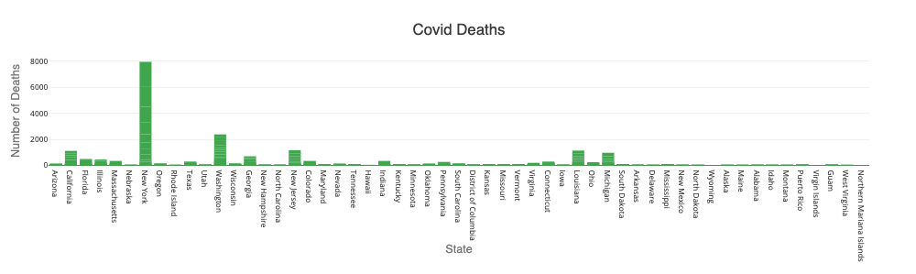
Analysis 3: Covid deaths by state
Visualization = Bar Graph
JS Library = Plotly
Filterable by Month

Slide 7
Deliverables
Features
Flask App = yes
HTML, CSS, Javascript = yes
Database = yes, MongoDB
Uncovered JS Library = yes, Chart.JS
Dataset with at least 100 records = yes
User Driven Interaction = yes, dropdown filters
At least 3 views = yes

Slide 8
Questions?

